Slide 1


EXERCISE 3 – ITEMIS
“Formalize with itemis create the state machine for the elevator described above or of another device of your choice that has a list one interaction with a human (i.e. button press).”
Course: Formal Methods 2024/2025
Team: Federica Picca -
Alberta Motca Schnabel

Slide 2
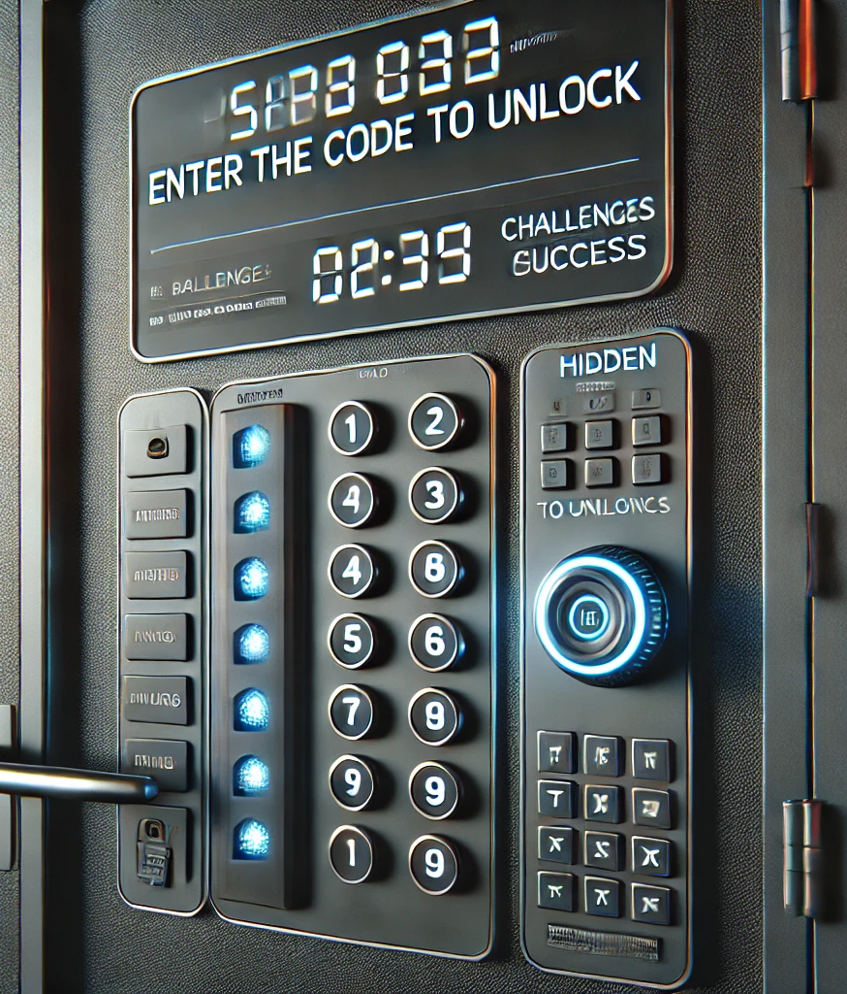
Model’s description – Interactive door for Escape Room
In an escape room, the interactive door is the main mechanism that regulates access to the next room. This door:
Interacts with players via a numeric keypad and a timer.
Changes state based on the inputs received or the fulfillment of certain conditions.

Slide 3
STATES
Locked: The door is locked and waiting for the correct code.
Challenge: The door requires the completion of a secondary quest, which involves pressing a hidden button to reveal the code needed for opening it.
Unlocked: The door is unlocked and can be opened.
Error: after one failed attempt, either because the entered code is incorrect or the time limit has expired
Exit: after more than 3 failed attempts

Slide 4
User Interactions and Game constraints
- User Interaction - Access Code: The user enters a numeric code.
Time Constraint: The timer starts at 3 minutes and decrements every second.
Attempt Constraint: After 3 incorrect code entries, an error is triggered.

Slide 5
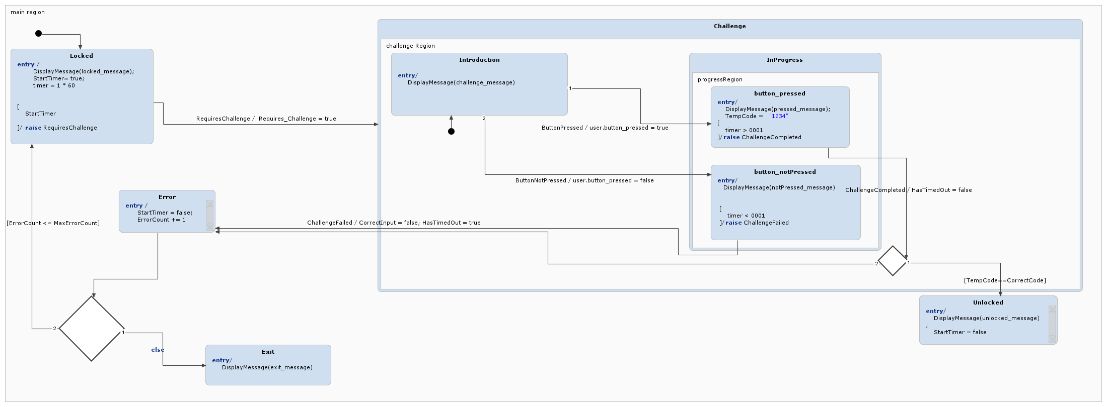
STATE CHART DIAGRAM

Slide 6
Locked state
Initially, the door is locked, and players see the message: "Locked. Insert the code."
A 3-minute timer starts, during which players must unlock the door.
This begins a quest where players must uncover the code.

Slide 7
Challenge Region
This leads us to the Challenge Region. Here, players are presented with their objective and the failure criteria:
"Find and press the hidden button in the room to reveal the correct code on the center monitor. Enter this code on the keypad to unlock the door. You have only 3 attempts, each with a 3-minute time limit to complete the task.If the button isn’t pressed or the code is wrong, you will lose a life. Act quickly – time is running out."

Slide 8
Challenge execution
If the players manage to identify and press the button before the time runs out, the unlock code, identified by the variable CorrectCode, will be displayed to them. The players will then have the code needed to unlock the door.
The variable TempCode represents the code entered by the players. If the entered code is correct, the door will be unlocked, and the state will change to Unlocked. It will therefore display the following message:
“System unlocked. You can open the door!”
Otherwise, if the time has expired or the entered code is incorrect, the state will change to Error:
“Error state, try again”

Slide 9
Attempt management
The Error state is activated in the following cases:
The player fails to find and press the button before the time runs out and therefore does not have the unlock code.
The player presses the button and obtains the code but enters a different, incorrect code.
In the Error state, a check is made on the number of attempts. If the number of attempts is 1, 2, or 3, the player has the chance to try again, and the system returns to the Locked state.
If the number of attempts reaches 4, the system transitions to the Exit state, and the player is shown the message:
"You have exceeded the 3 allowed attempts. You have lost the challenge!"

Slide 10
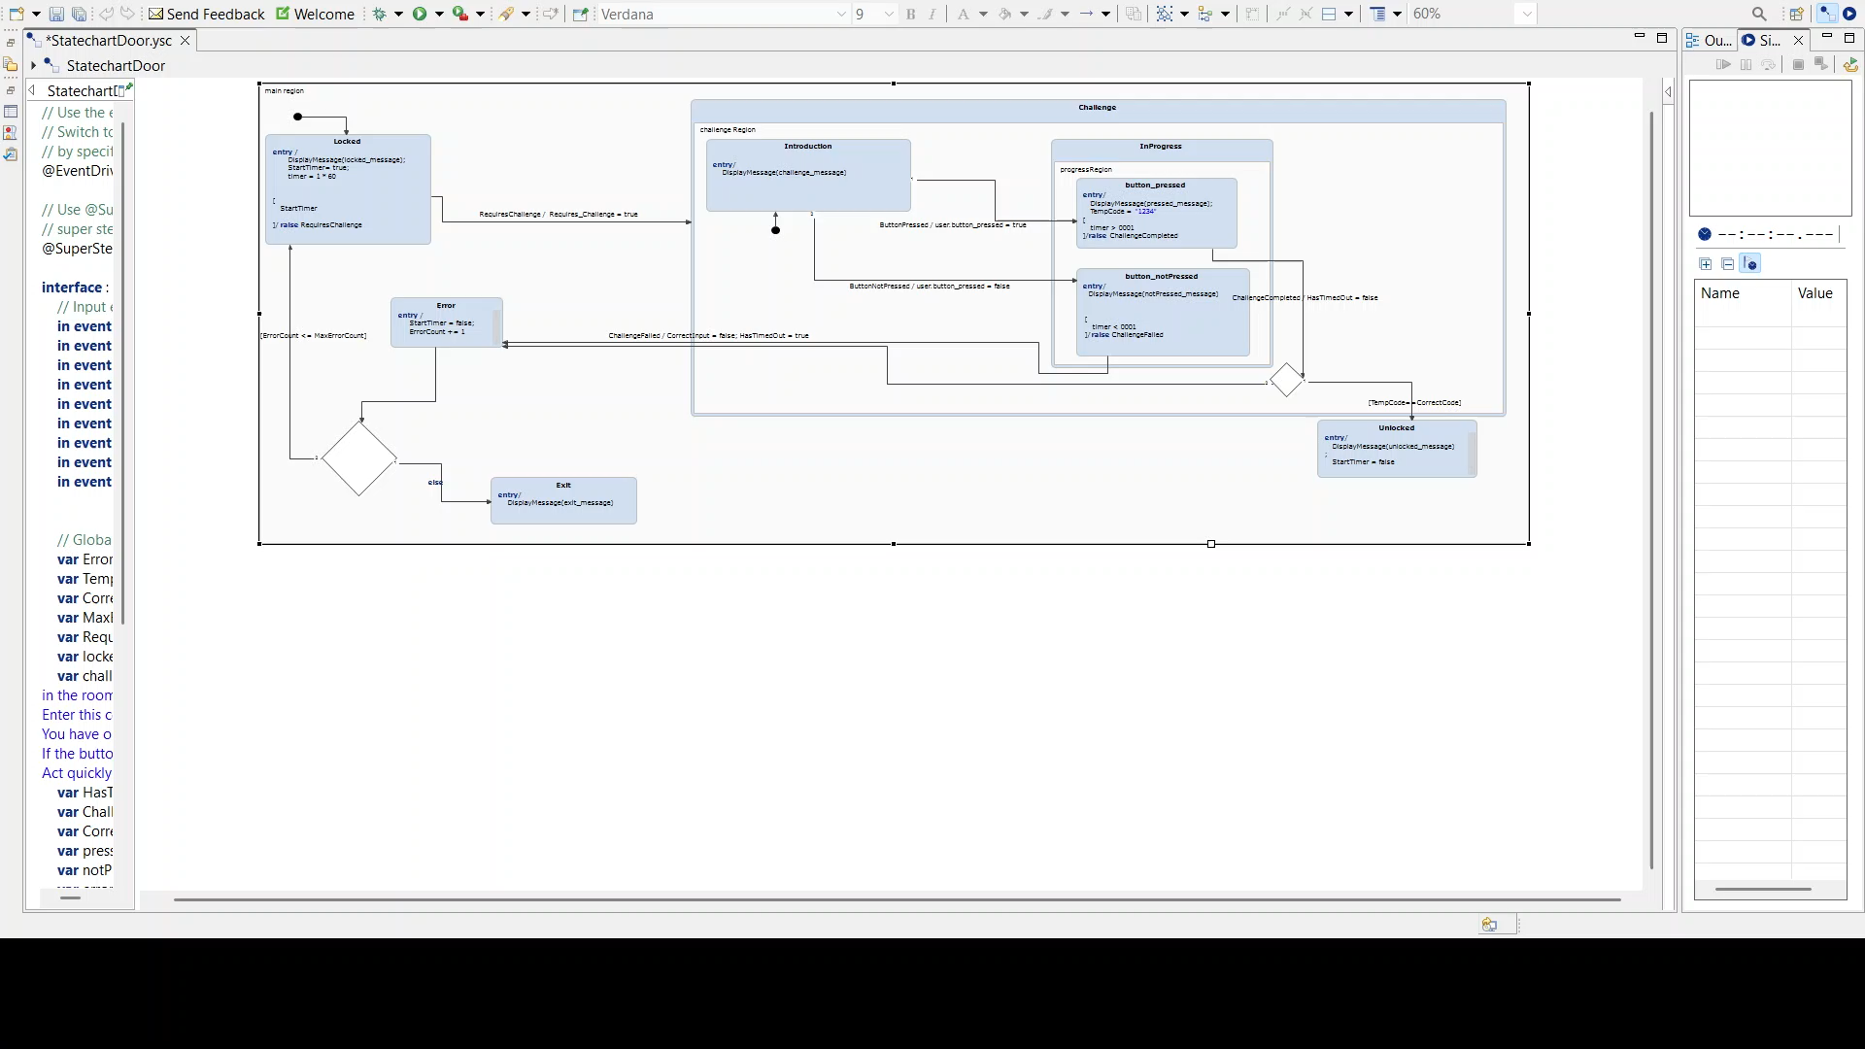
VIDEO
This video shows:
The case where the button is pressed and the entered code is correct, resulting in the door being unlocked.
The case where the button is pressed, but the code entered by the user is incorrect, causing the system to transition to the Error state.

Slide 11
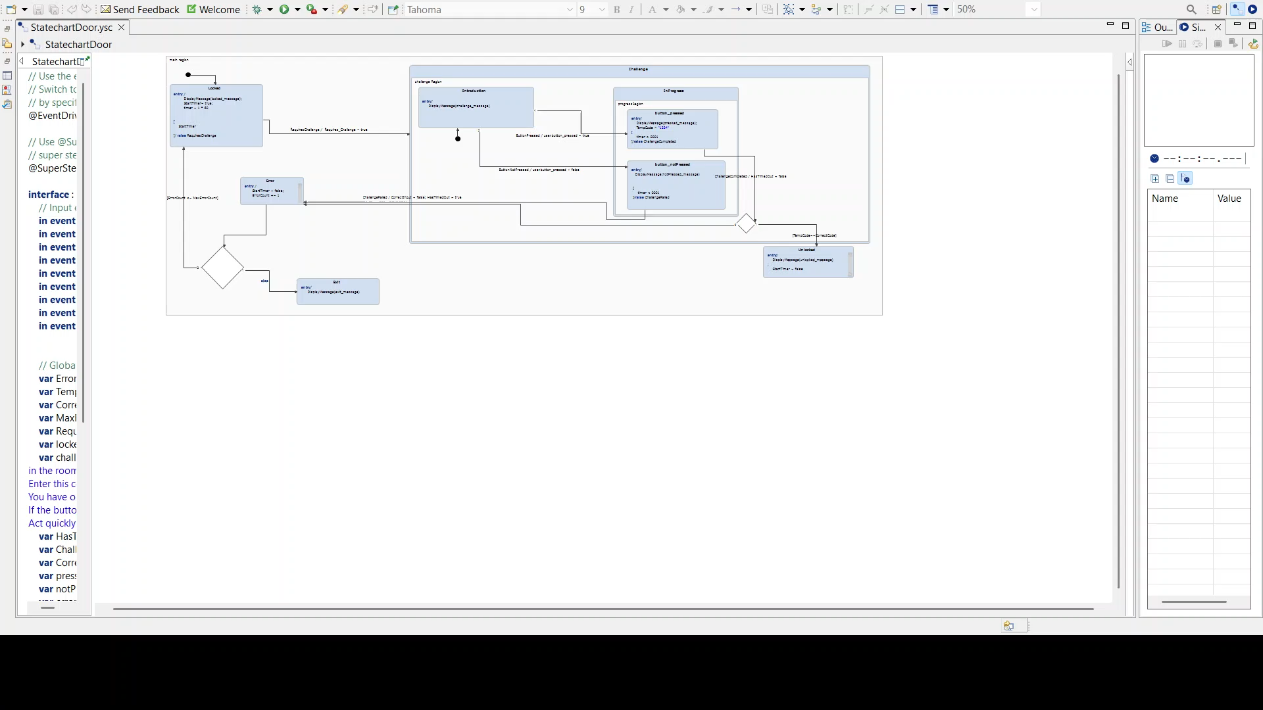
VIDEO
This video shows the case where the button is not found and pressed before the time runs out, three times in a row.
The player never obtains the code, so at the end of the third attempt, the system enters the Exit state.

